Slide 1



Dolphin MSE M, OM conditioning & spatial simulation
Presentation 2: For the Tech Team
1st November 2024
Dolphin MSE M - OM conditioning - Spatial approximation.pptx
Tom Carruthers

Slide 2
Contents
Where we are at
Some notes on M
Operating model conditioning
Capturing spatial dynamics
Next steps
Schedule - presenting results to the wider groups

Slide 3
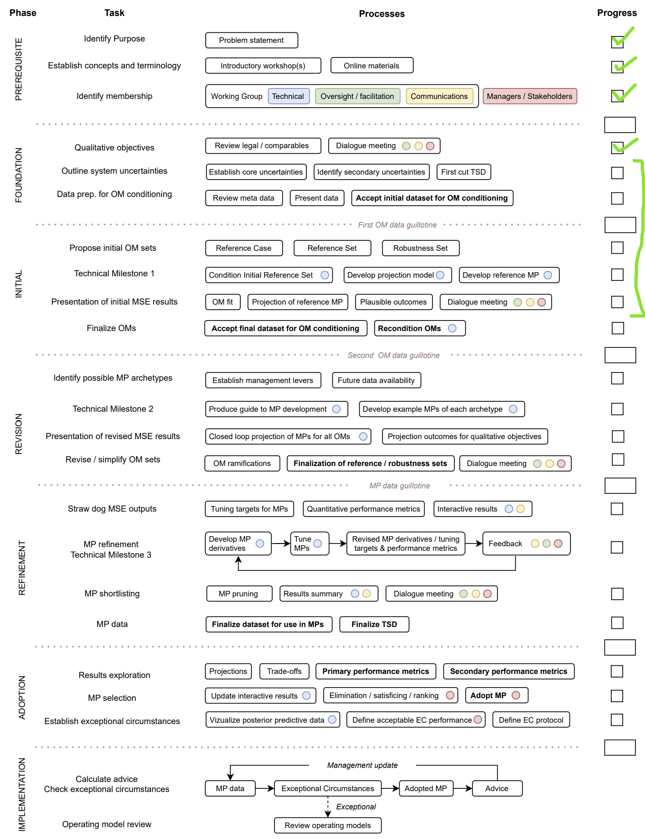
1. Where we are at:
Link to paper

Slide 4
2. Notes on M
Hard to pin down but important since it fundamentally determines productivity and the relative impact of fishing mortality (and reference points)
Default assumption is 3.2 / yr (4% survival to 12 months)
Higher M
There are stocks of dolphinfish with fast growth (higher K) consistent with higher M
Total mortality estimates have been estimated for some stocks in other regions above 4.0 yr⁻¹
Contrary information comes from a single regional study (Schwenke and Buckel 2008)
Lower M
A regional study (Schwenke and Buckel 2008) sampled 59 fish older than 24 months and 13 older than 36 months. This is extremely unlikely for total Z above 2.0 yr⁻¹ given that only 1000s of fish were sampled.
Regional K values are much lower than those recorded for high mortality rate stocks / areas elsewhere.

Slide 5
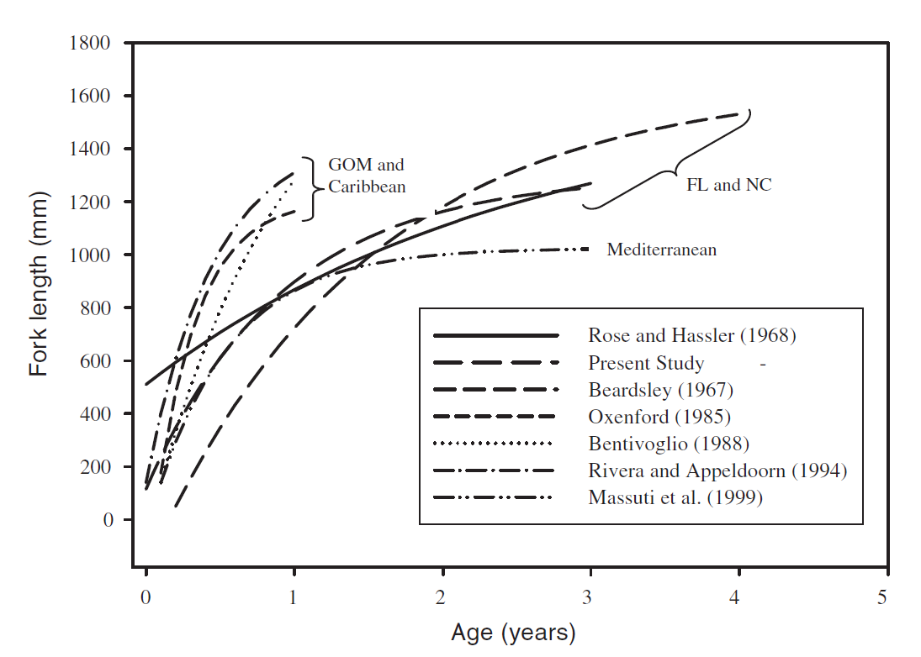
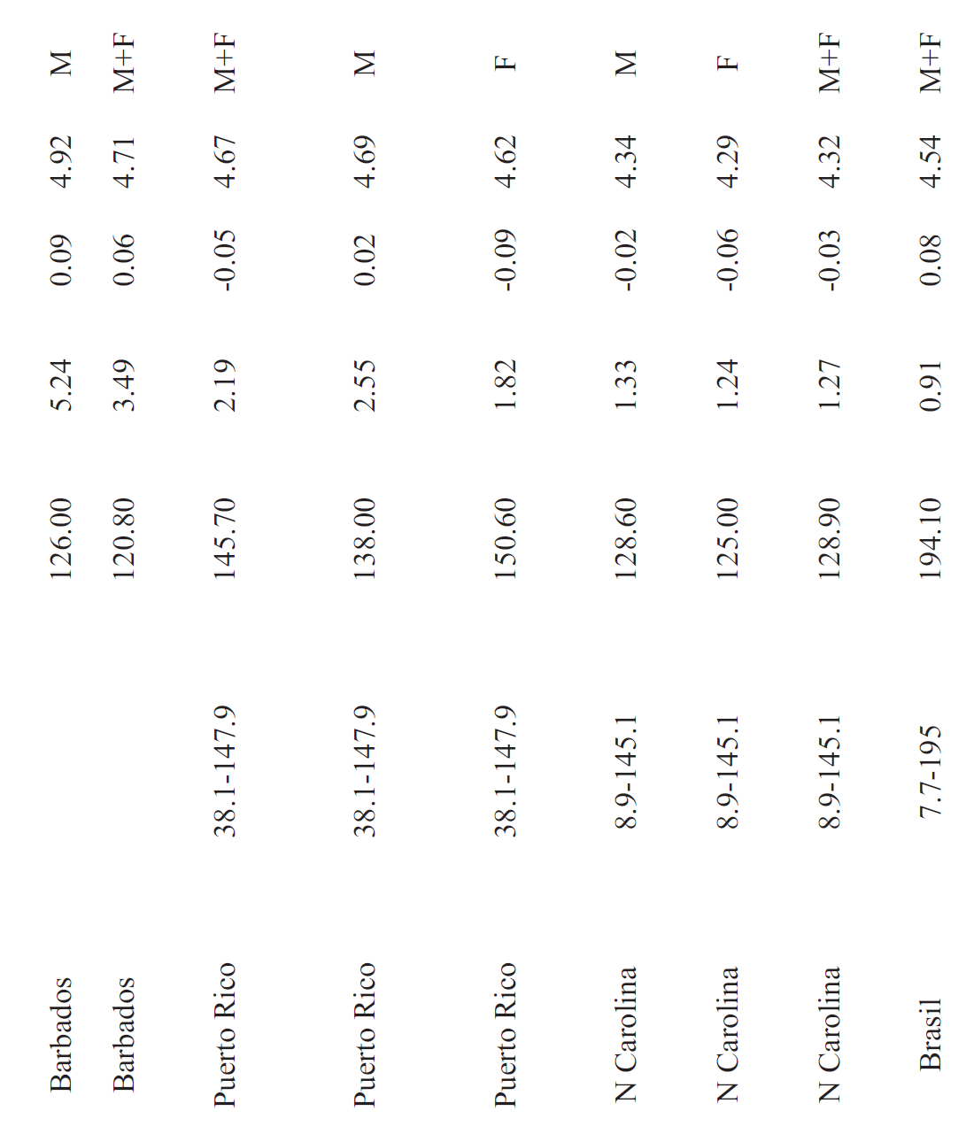
Can be fast growing – high M
Molto et al. 2020
Linf K
Very high variability in life-history among regions making meta-analysis problematic.
Swenke and Buckel 2008
Higher M (almost annual)
Lower M (can get to age 2, 3)

Slide 6
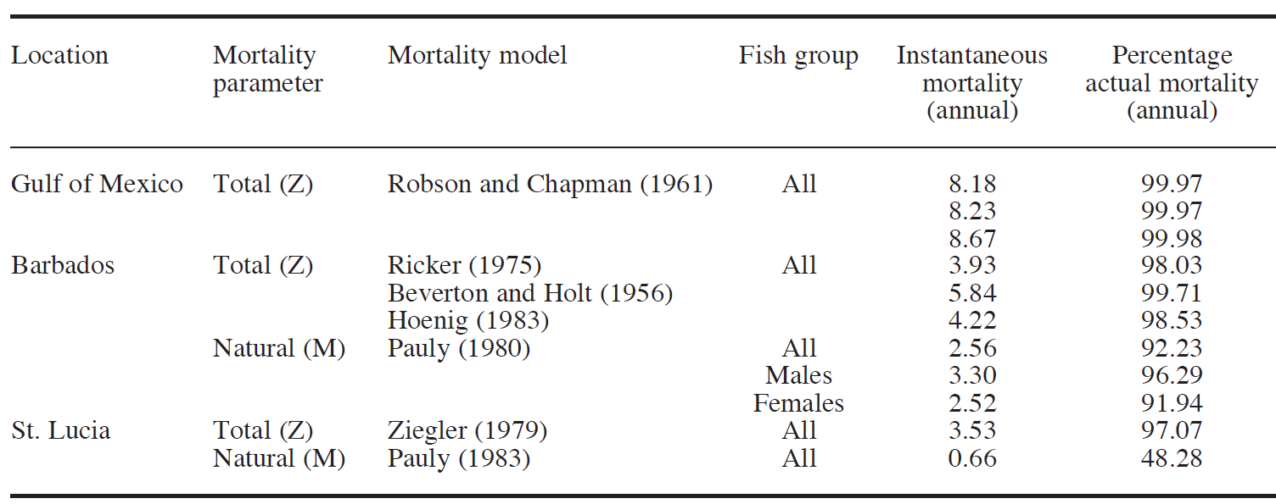
High mortality rates (Z / M) observed / estimated in other areas / stocks
Oxenford 1999

Slide 7
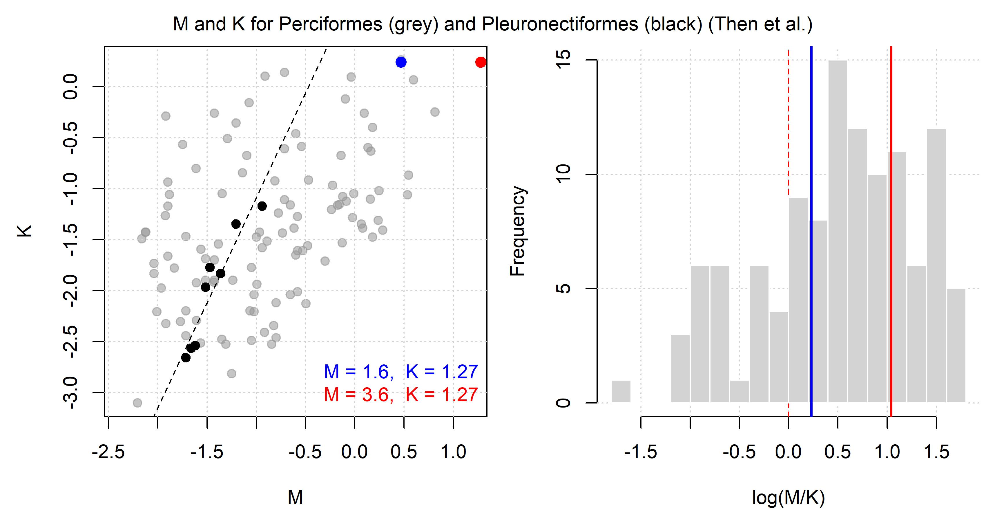
Meta analysis is inconclusive. A wide range of M is plausible at the observed K value of 1.27

Slide 8
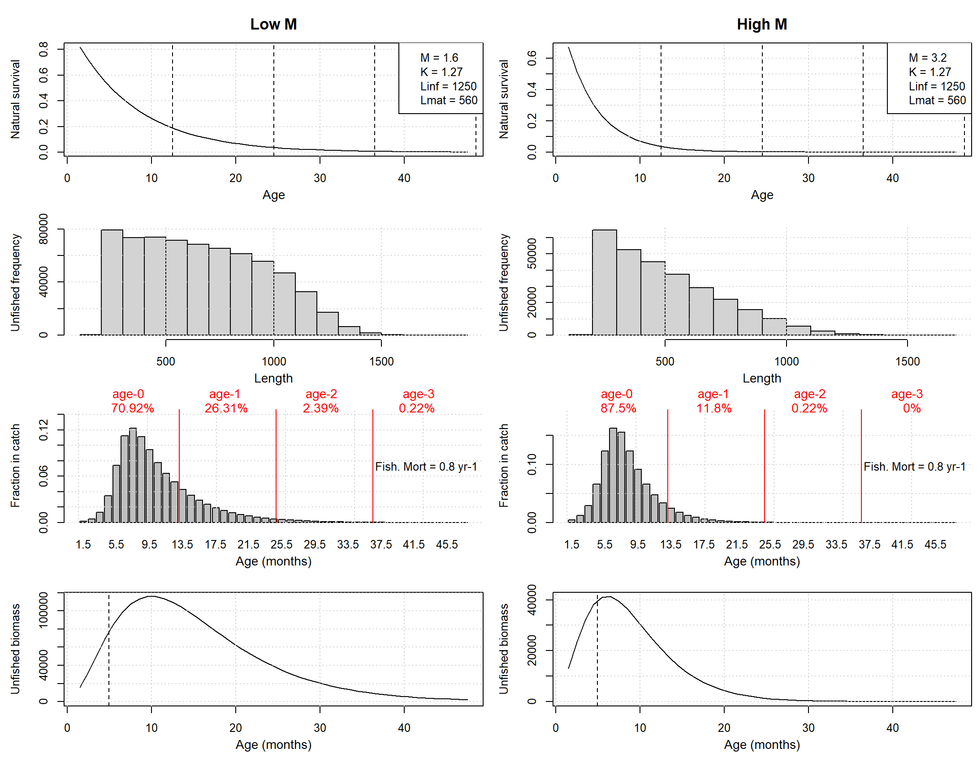
Spawning potential analysis Also pretty inconclusive…
Would expect maturity near the mode of the unfished spawning biomass

Slide 9
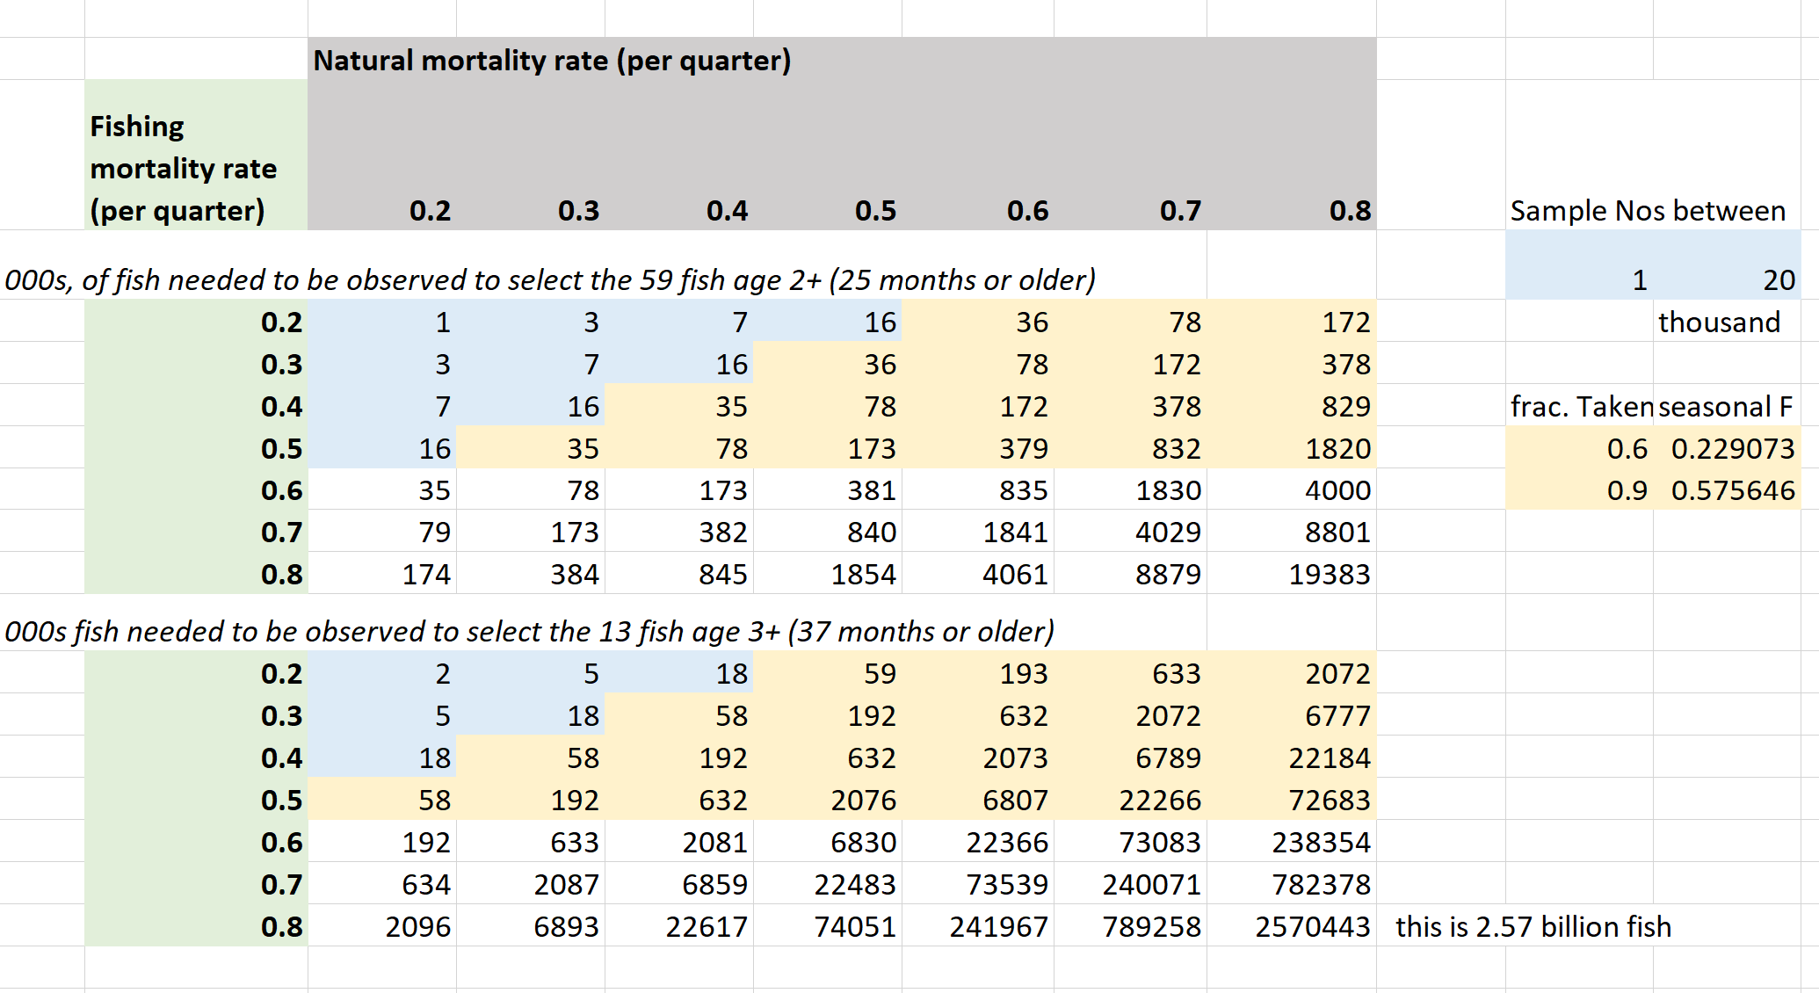
How many fish did Jeff et al sample?
Are these aging data:
- Representative of the stock (substock or rare strong cohort)?
Reliable?

Slide 10
M conclusions (and please fee free to express other views!!)
Highly uncertain
Can’t borrow parameters from other areas (far too variable for that)
A single study provides region-specific estimates of growth and maturity (Swenke & Buckel 2008).
The K / Linf values from that are consistent with lower natural mortality rates than estimated for other areas for example the GOM and Caribbean.
The maturity 100% at ~550mm is not inconsistent with high M values
If they are reliable and representative, the sampling of 2+ and 3+ age fish is highly inconsistent with the high M scenario
If lower M scenarios are included, the high M scenario will not be a pinch-point for MP selection (historical and current Fs must be smaller, sustainable removal rates will be much higher)
Additional corroborating data are desperately needed (tagging, growth, age samples).

Slide 11
3. Operating model conditioning: configuration
Using a statistical catch-at-length approach in TMB called RCM (Rapid Conditioning Model, OpenMSE package).
The operating model includes stochastic draws of parameters such as M and the somatic growth parameters. RCM conducts an MLE fit to each of the nsim draws. It also does a single fit at the mean value of all parameters (for more detailed diagnostics)
Spatially aggregated conditioning
Quarterly time step
Recruitment assumed to be possible in all time steps *
Fitting to historical total catches (CV 2.5%) and length samples by fleet (log normal LHF)
Abundance trends are informed by the aggregate VAST index (all areas combined)
Maturity and somatic growth are those of Swenke and Buckel (2008)
https://openmse.com/tutorial-rcm/

Slide 12
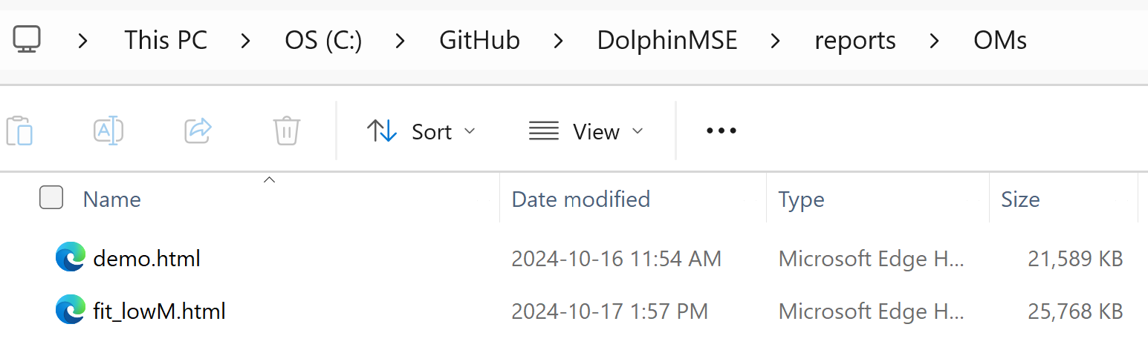
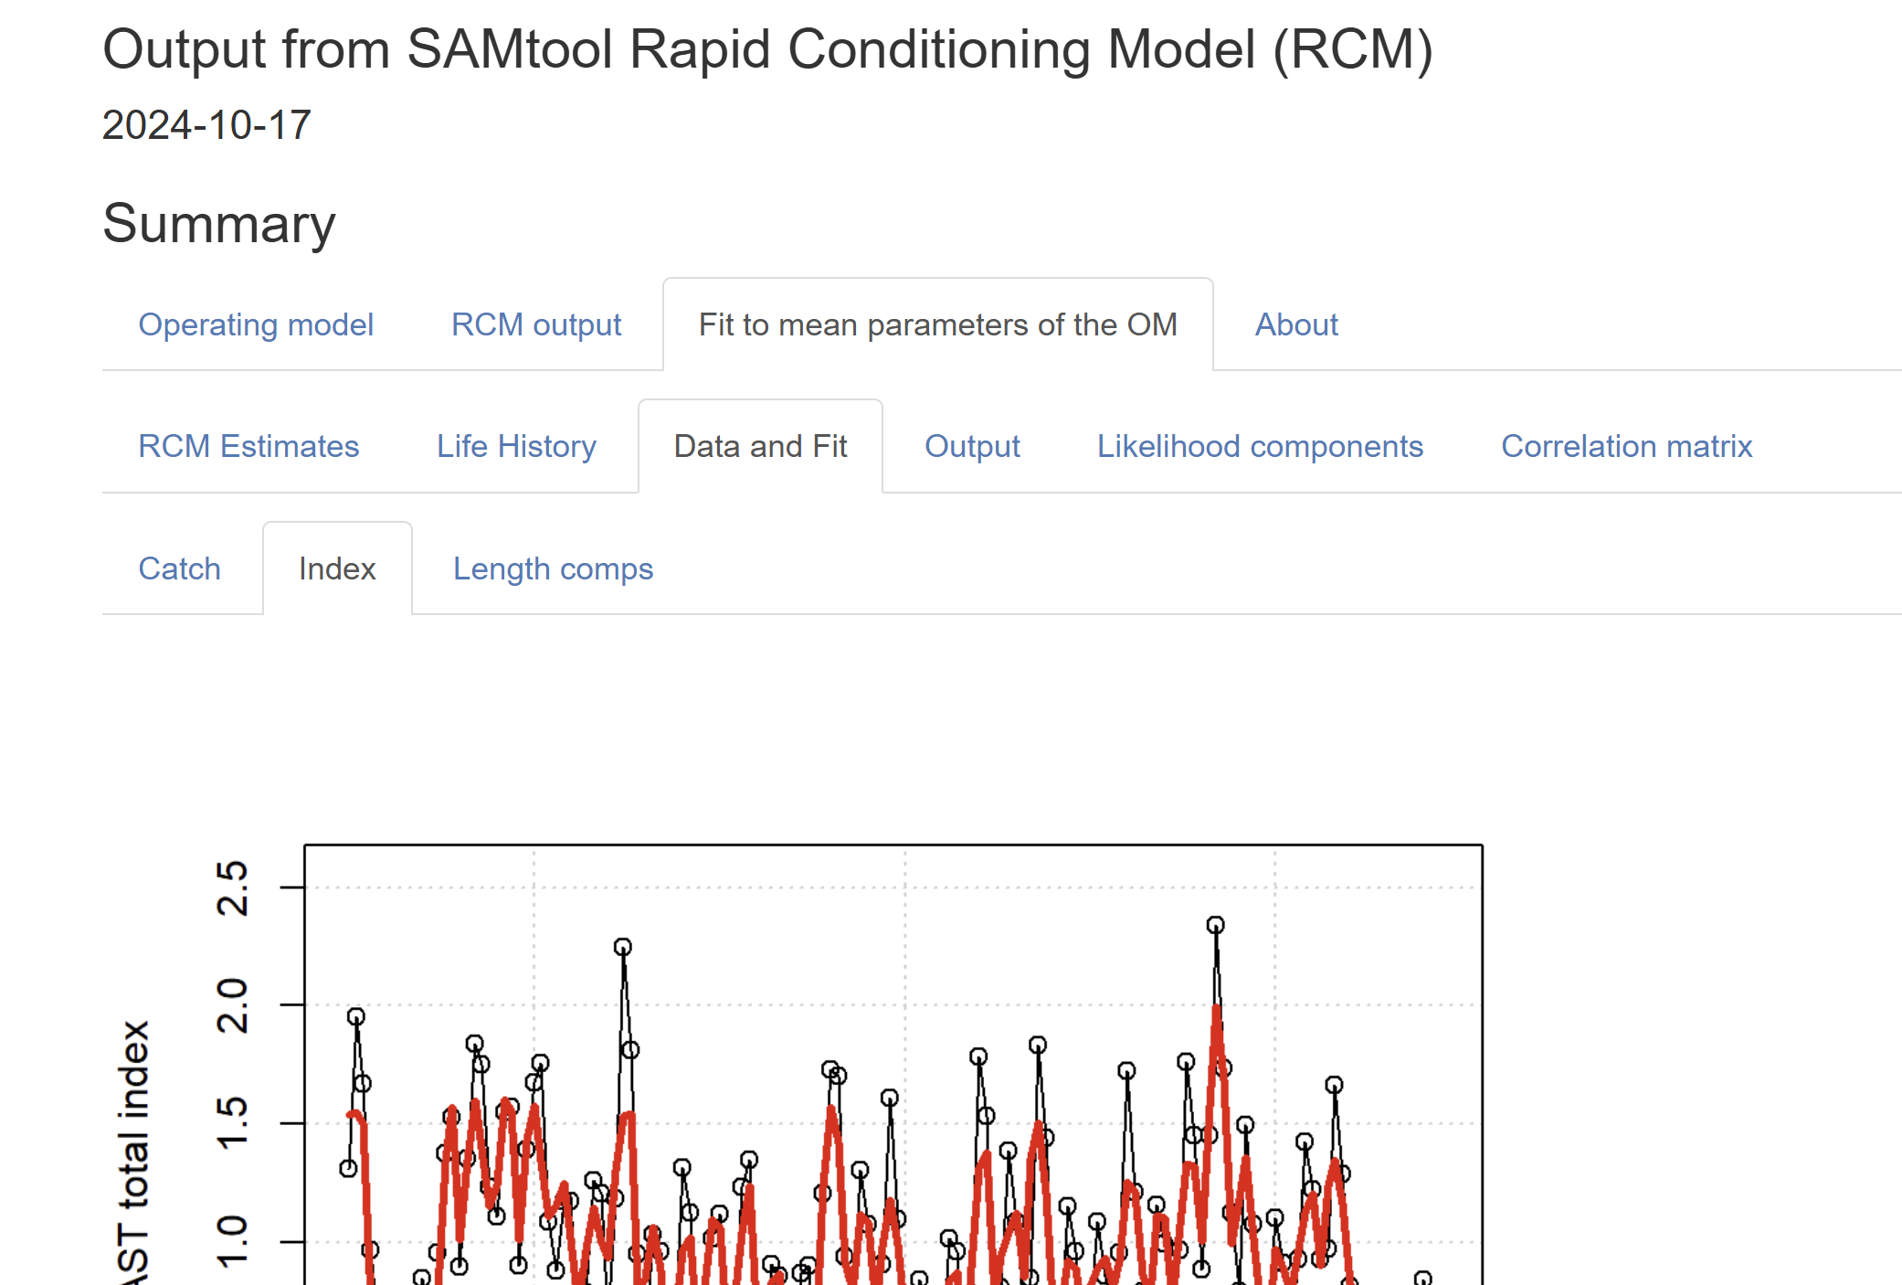

Slide 13
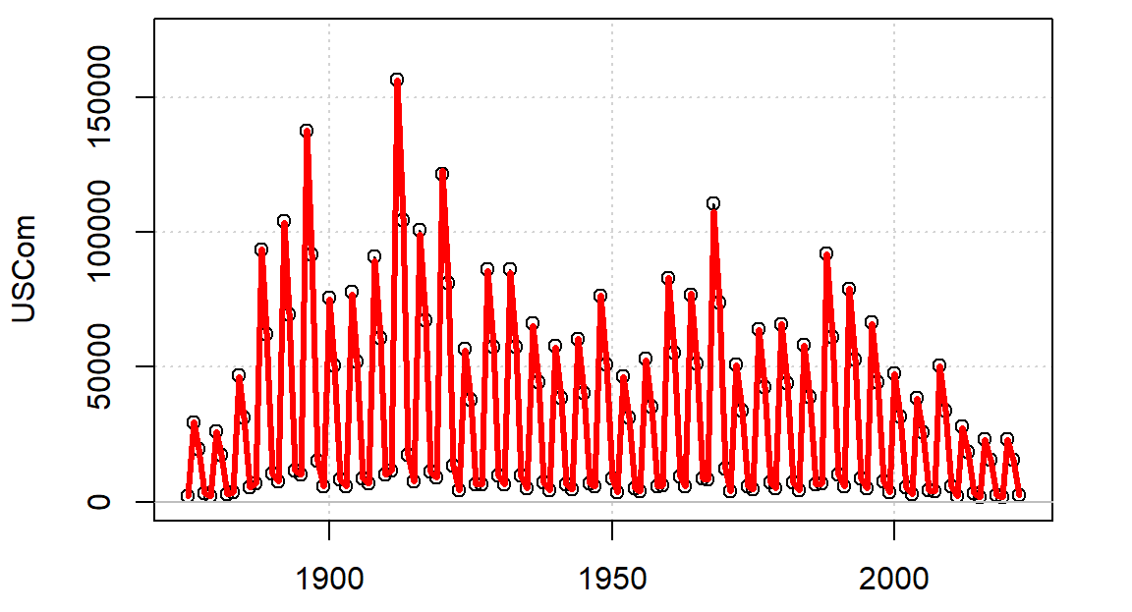
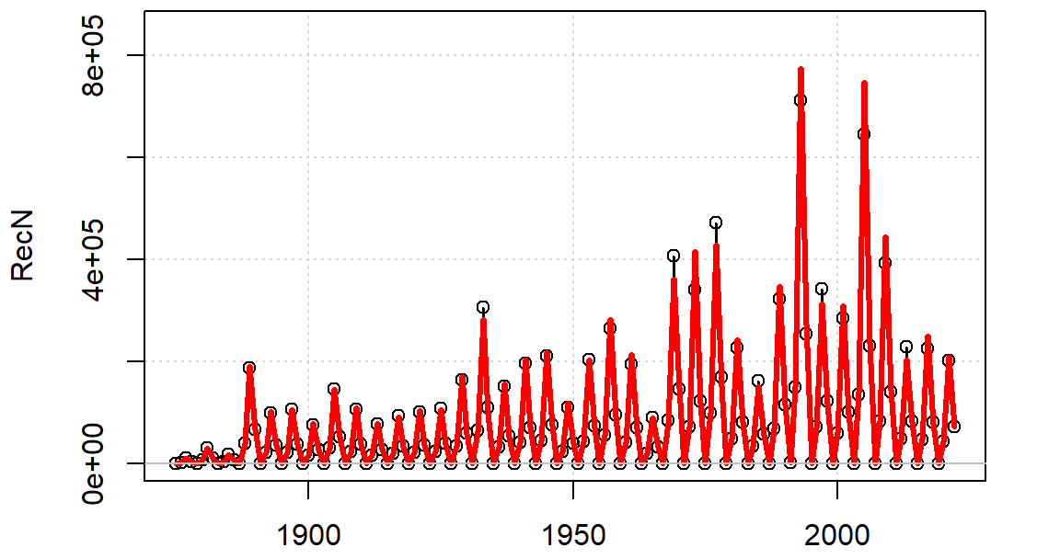
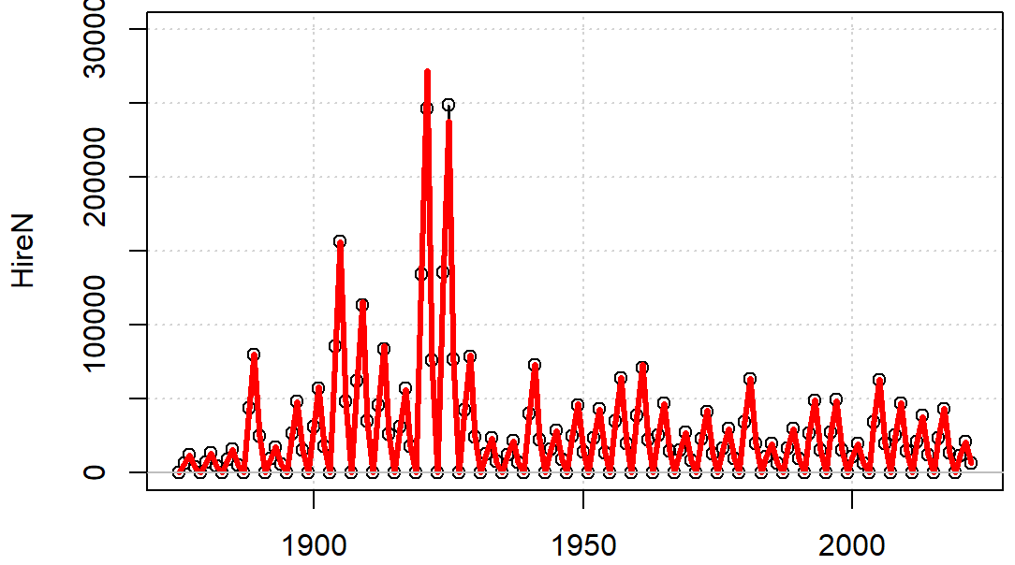
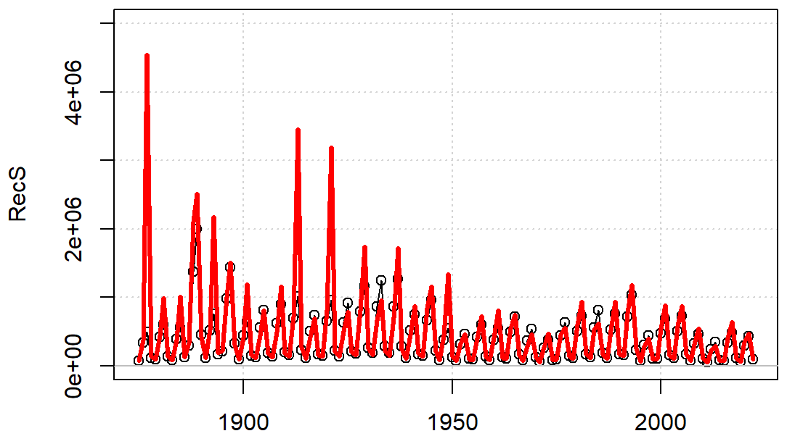
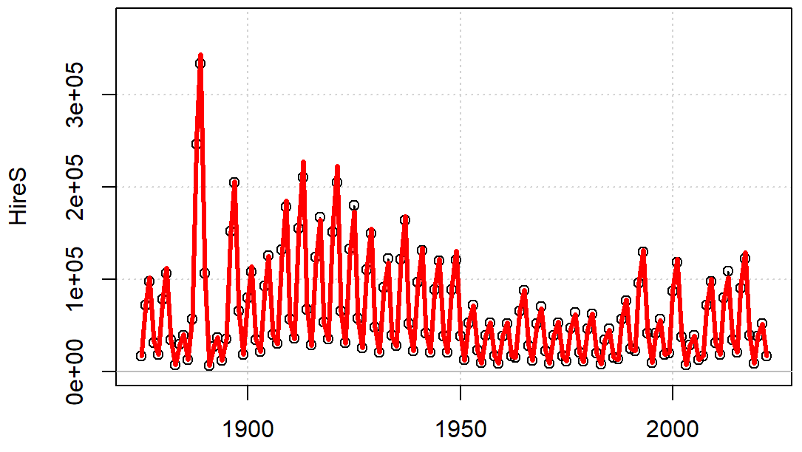
3. Operating model conditioning: initial fit- catches
CV = 10%
CV = 20%
Model predicted
Observed

Slide 14
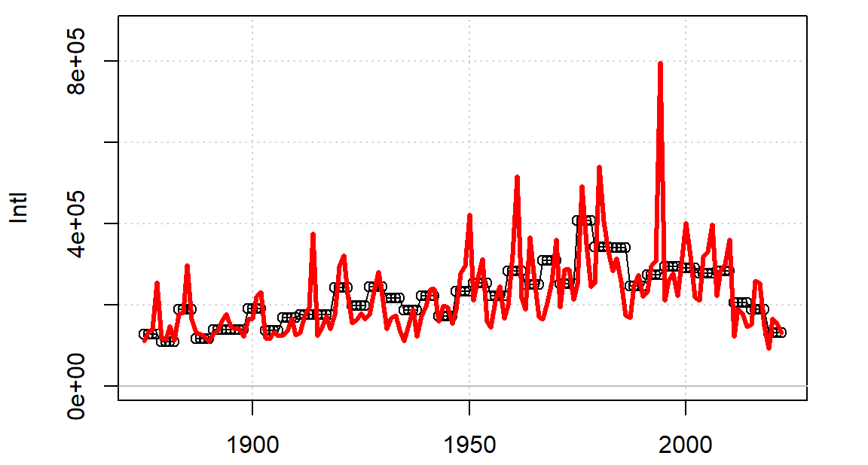
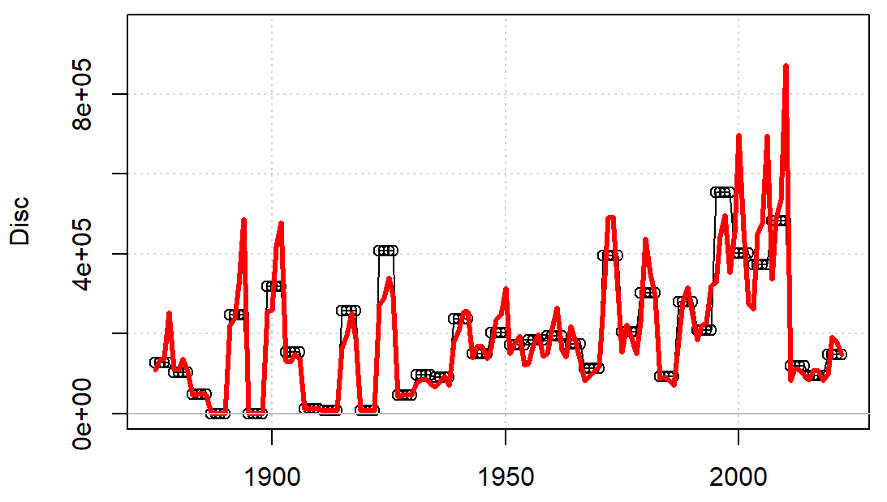
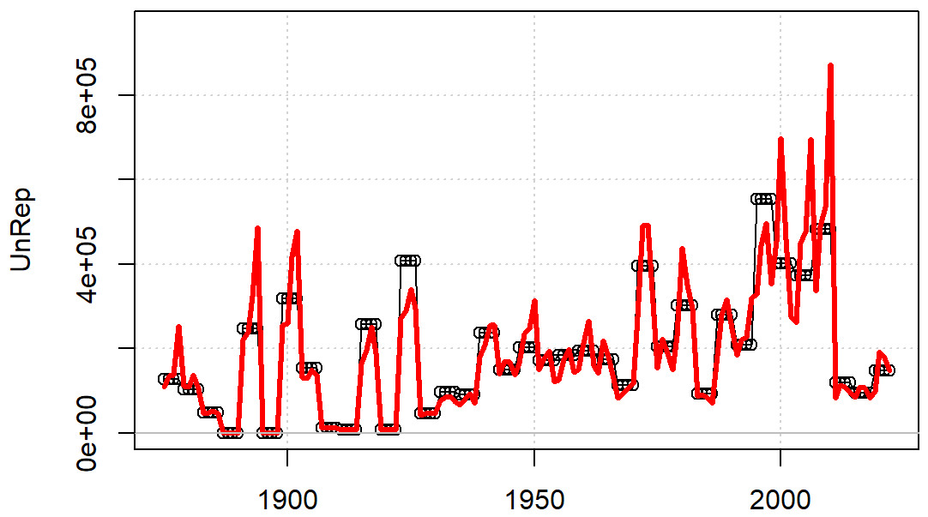
Other fleets - higher CV - model expects variability to avoid max F constraints
CV = 30%

Slide 15
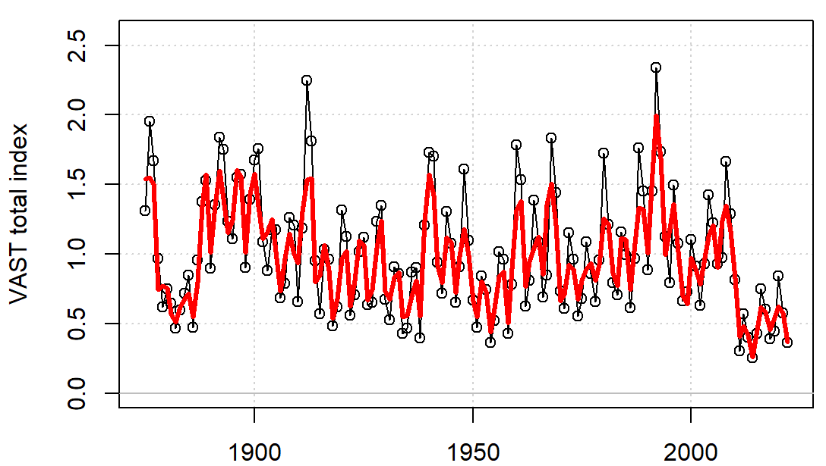
3. Operating model conditioning: initial fit - VAST index
Model captures trends but estimated abundance is more stable.
If length composition data are excluded (selectivities are not estimated, but prescribed), the model fits these data points almost exactly.
A CV of 10% was assumed here for all data points, those estimated by the VAST model will be included in the next run.

Slide 16
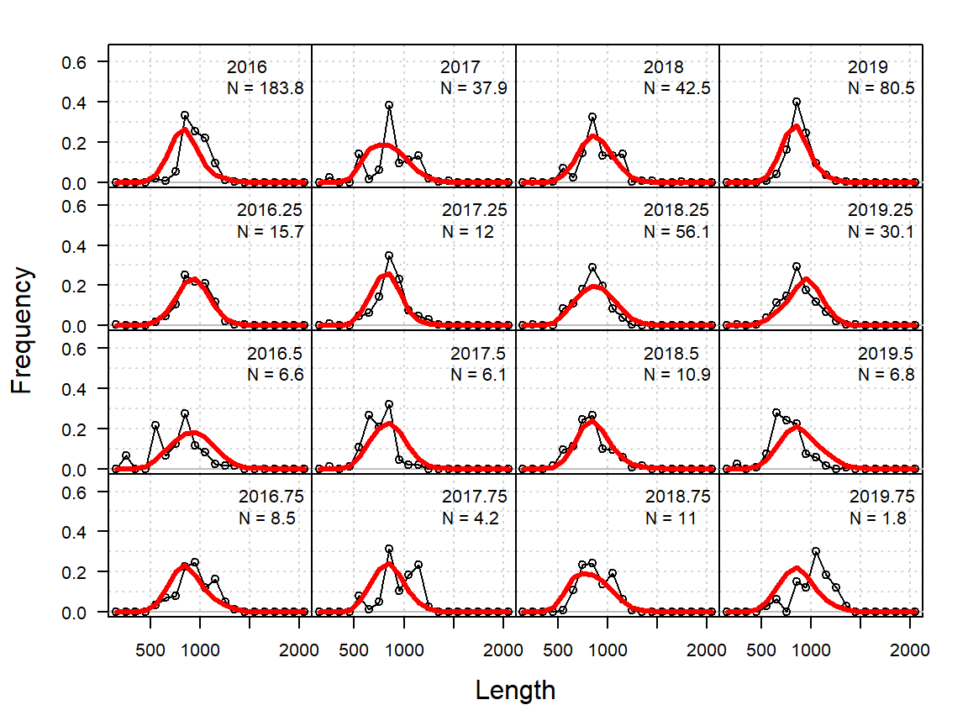
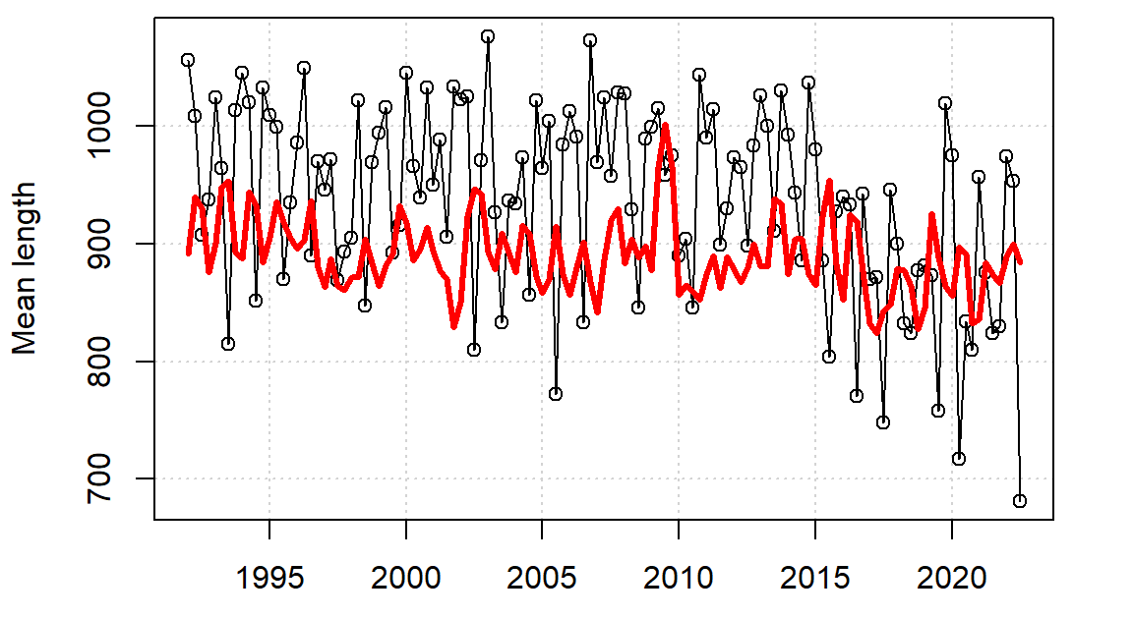
3. Operating model conditioning: initial fit – catch length compositions
Average effective sample size of 50 across all years (ie the mean of the number ‘N = ‘ in these plots is 50).
Attempting to fit a single, time-invariant selectivity to the length composition data of the observer program.
Fits are OKAY-ISH but struggle in some years. Some of the apparent mis-fitting is just down to low sample size years.
Mean length is less variable and systematically lower than observed for historical period.
USCOM 2016 – 2019 (example but indicative)

Slide 17
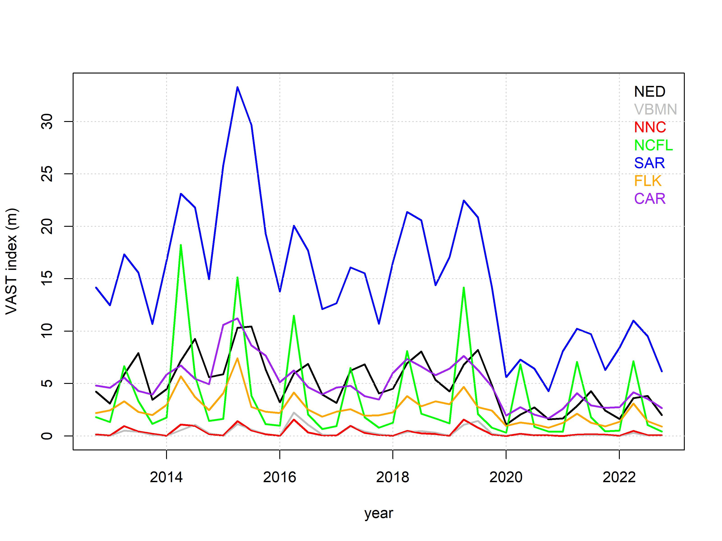
4. Capturing spatial dynamics for reconstruction / projection
Absolute abundance differences among areas
Seasonality in abundance
Varying seasonality among areas
Common overall trends in abundance

Slide 18
4. Capturing spatial dynamics for reconstruction / projection
Absolute abundance differences among areas
Seasonality in abundance
Varying seasonality among areas
Common overall trends in abundance

Slide 19
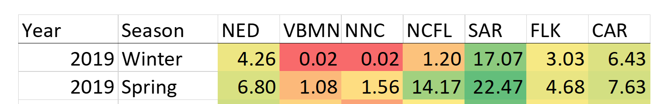
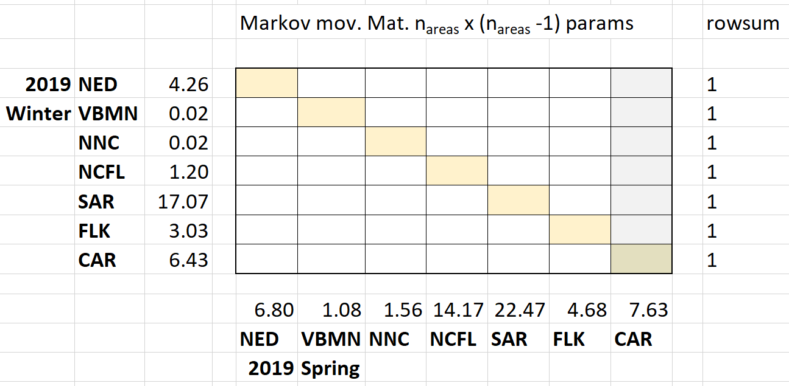
A movement matrix for every transition
That’s 42 parameters per transition.
Indeterminate unless we have at least 5 observations per row (e.g. tagging for almost every from-to area transition)
Not possible.
So what can we do?

Slide 20
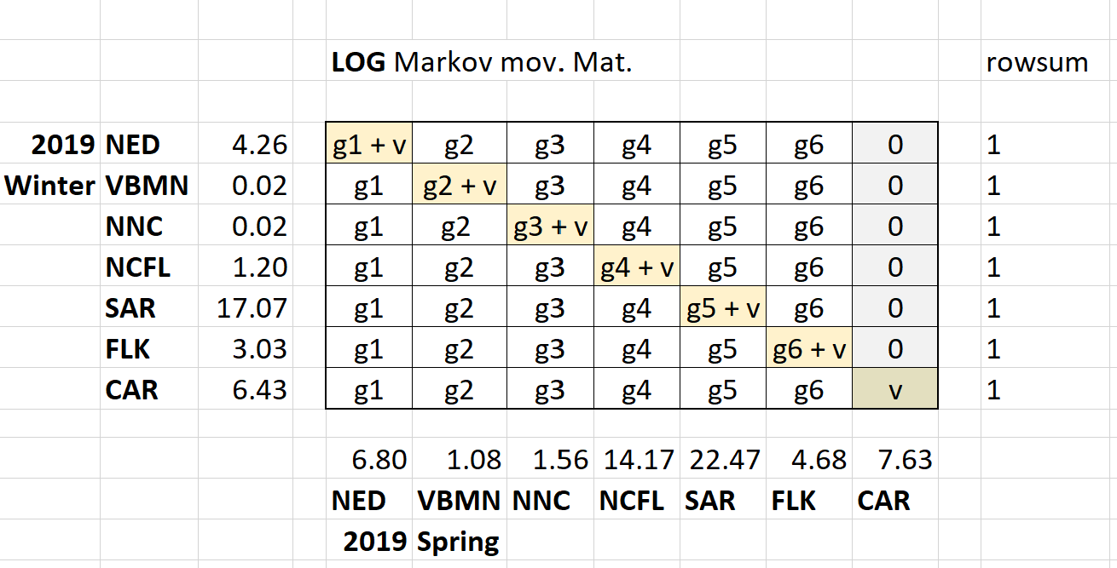
Simplify: The gravity formulation
Just n_{areas} parameters for an n_{areas} movement matrix
Assumes probability of staying (is log linearly related to gravity)
Can be estimated for every seasonal time step in the model

Slide 21
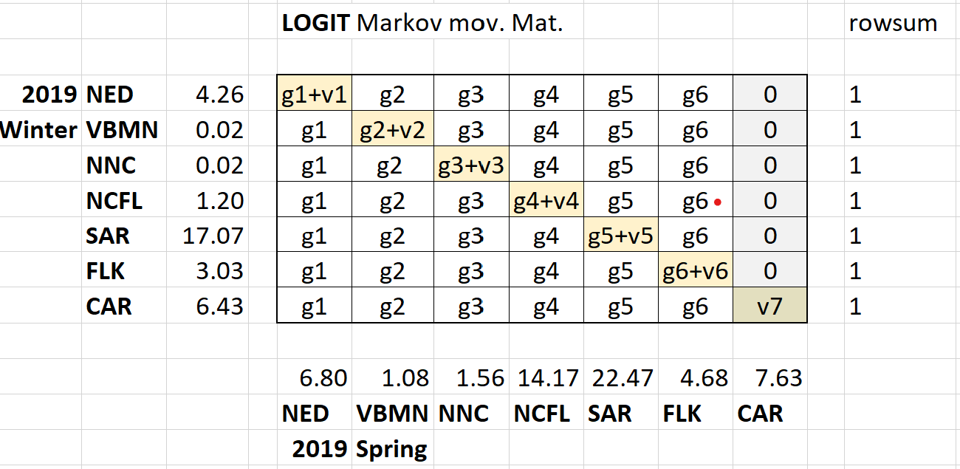
Simplify! The gravity formulation (version 2.0)
Logit-normal likelihood for observed fractions
Normal likelihood for v terms (you pick a target probability of staying for all areas, or each area)
Very weak lognormal penalty on g terms

Slide 22
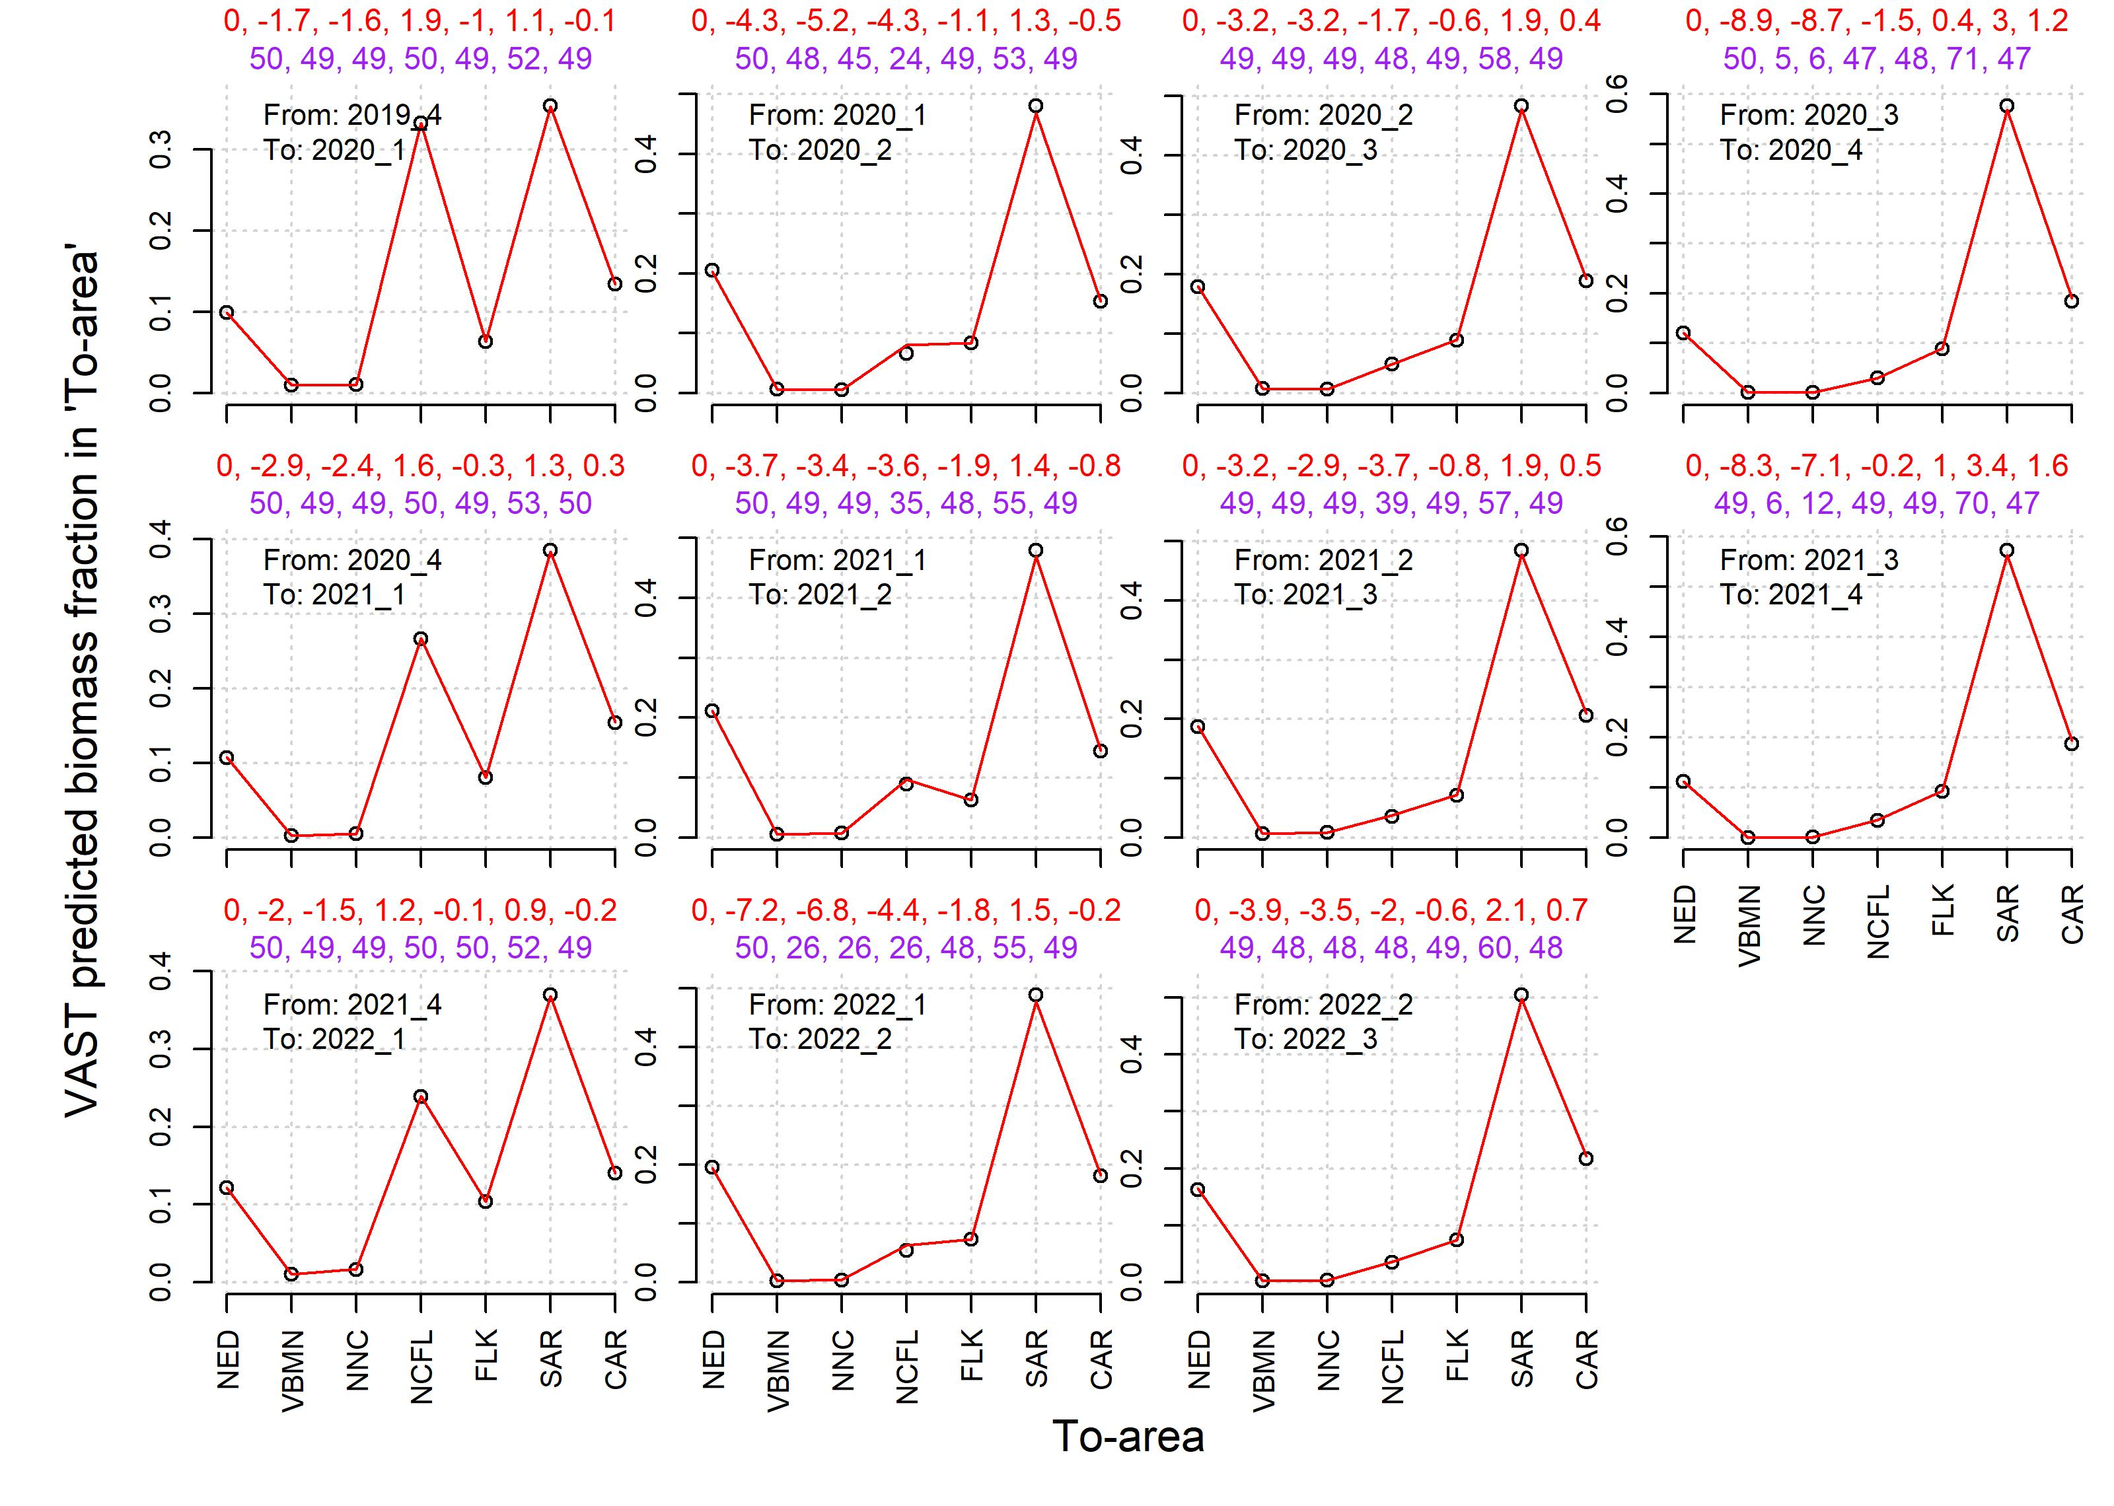
Historical fits
Aiming for a 50% probability of staying in each area
First gravity term was fixed at zero
Model fits were very good – we can approximate seasonal movement very well

Slide 23
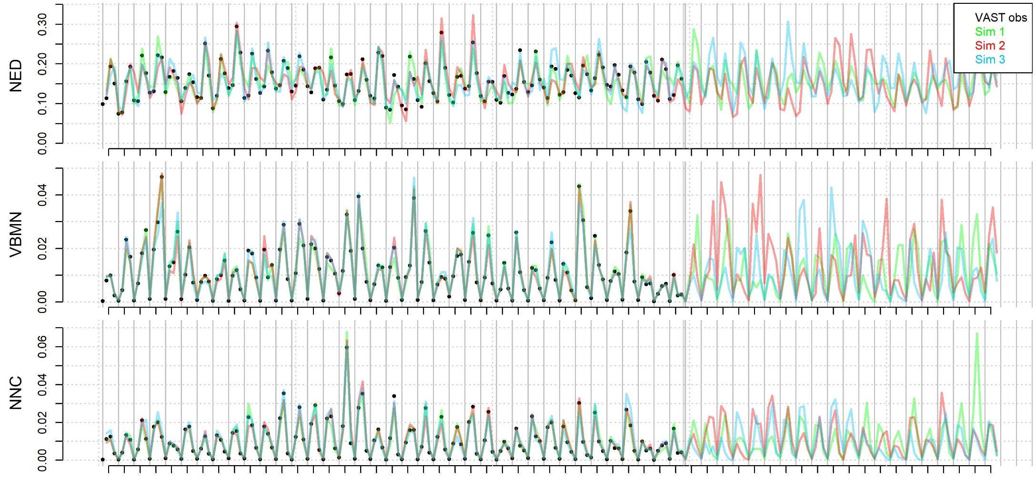
Simulating spatial / seasonal dynamics
Area / biomass fraction
Historical year (use fitted year/season & resample from var-covar)
Projection year (resample, year, season and var-covar)

Slide 24
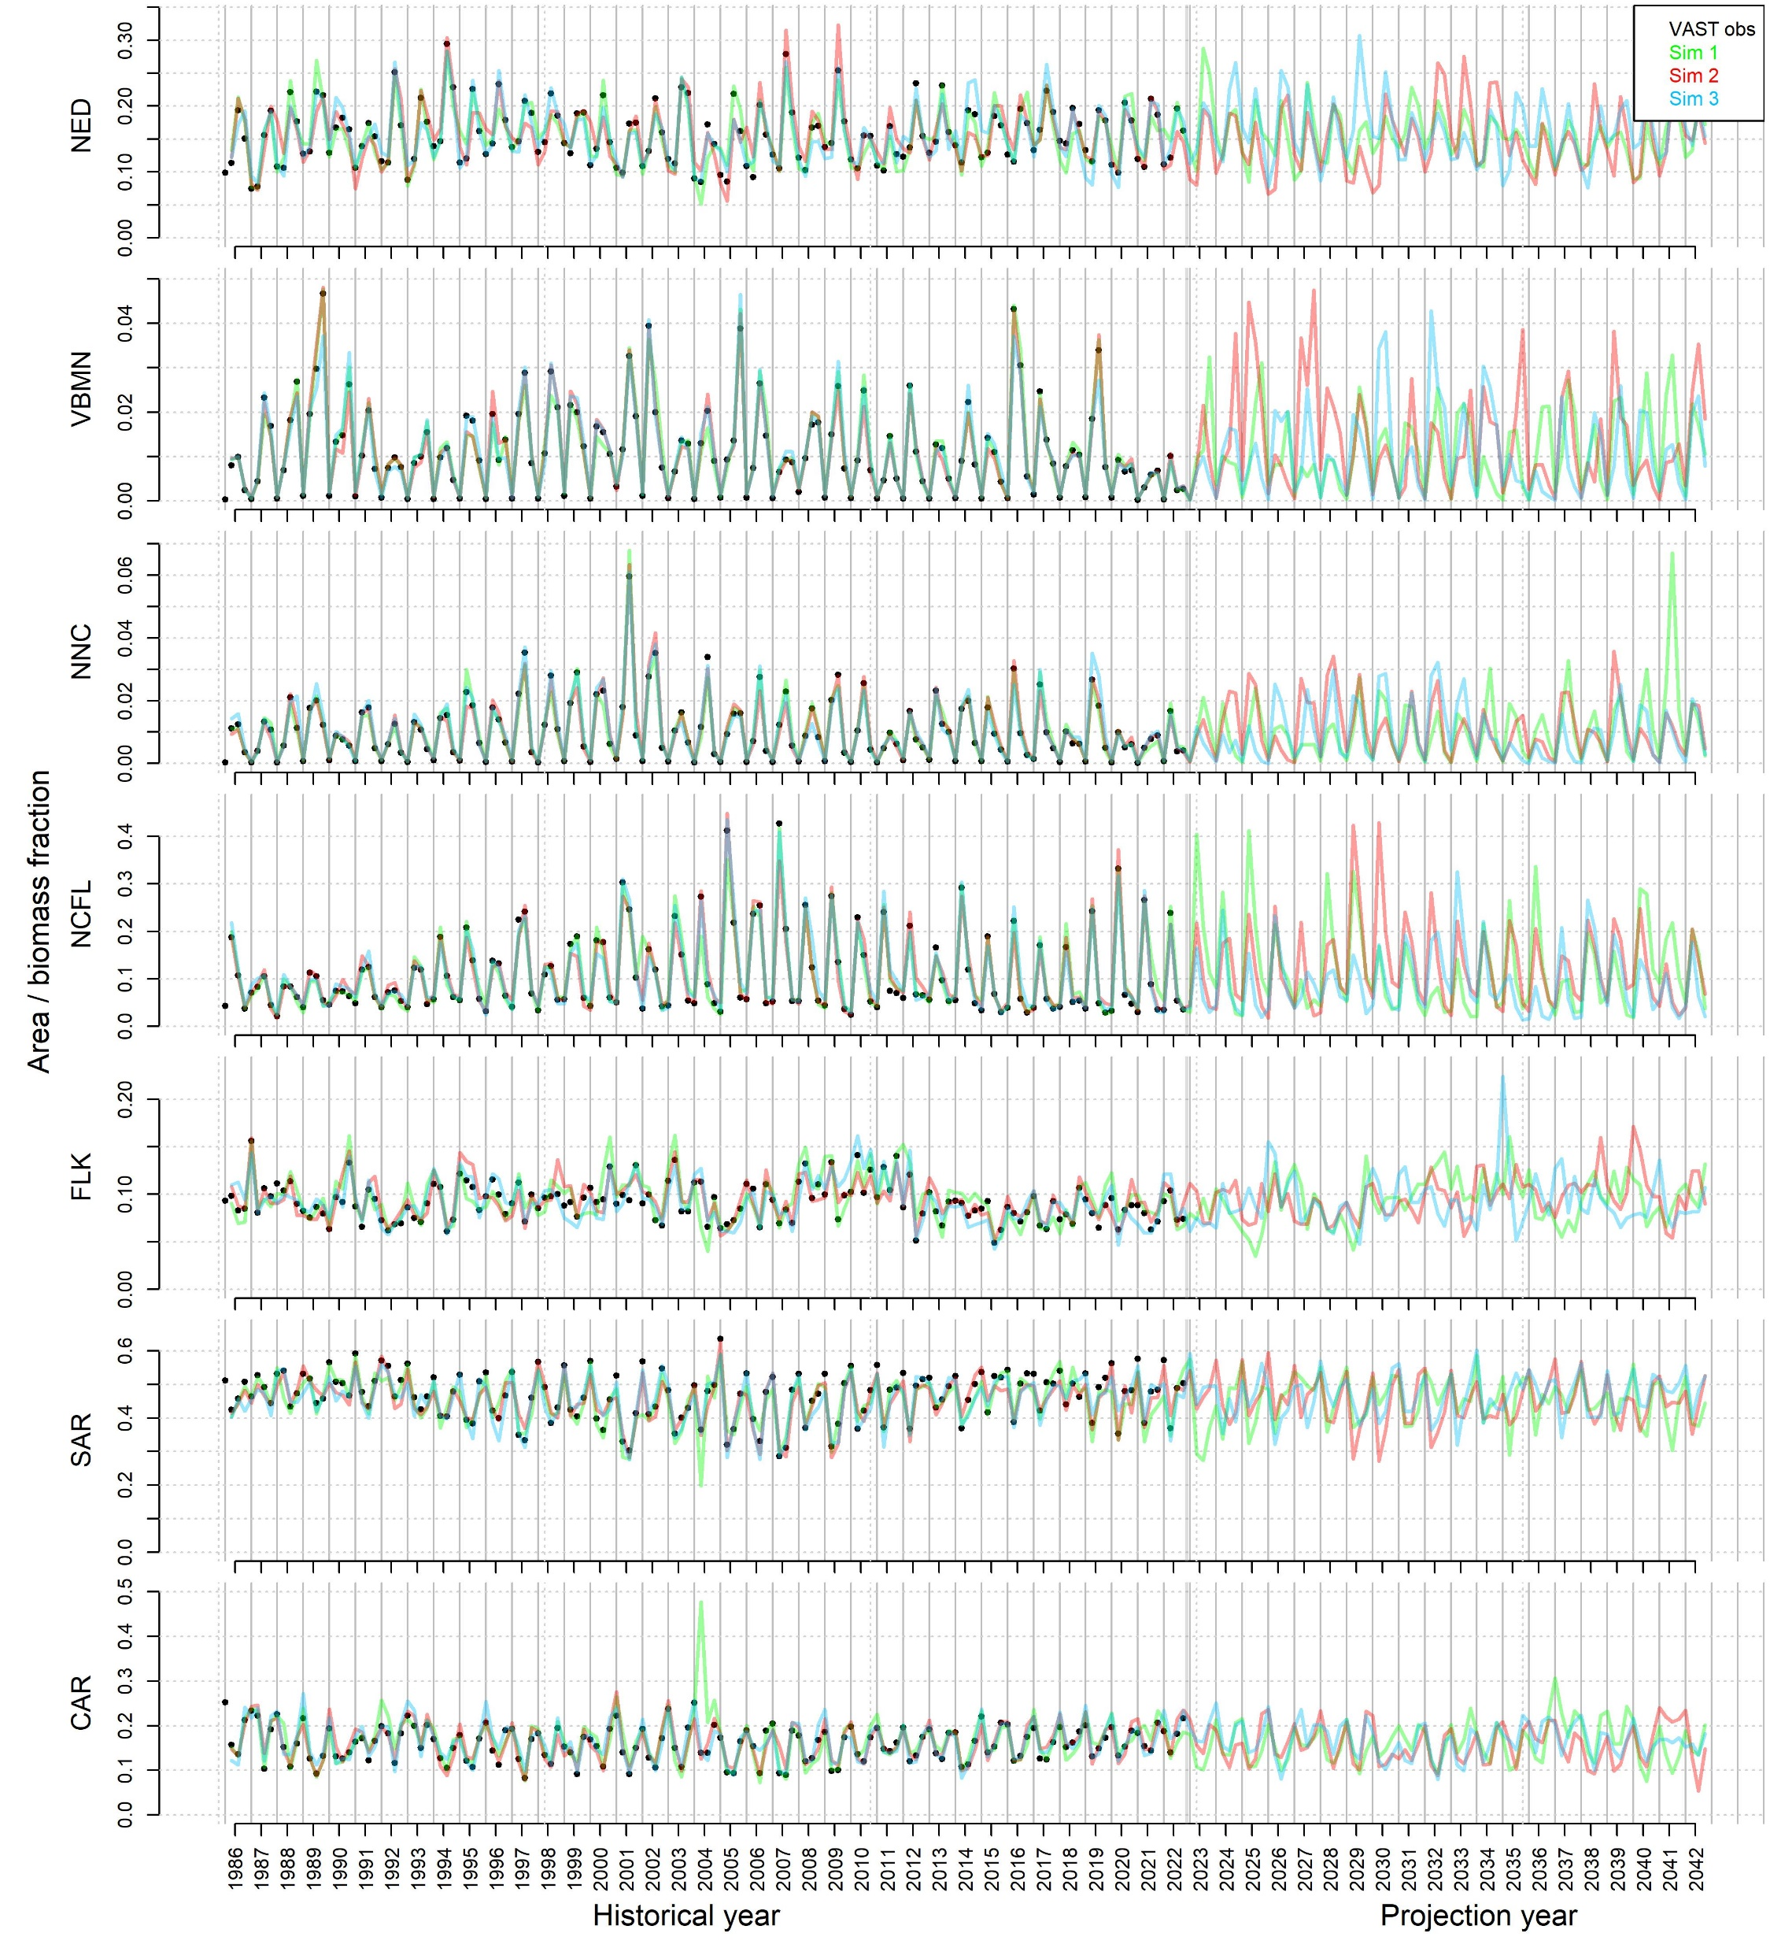
Simulating spatial seasonal dynamics
Absolute abundance differences among areas
Seasonality in abundance
Varying seasonality among areas
Common overall trends in abundance

Slide 25
Simulating spatial seasonal dynamics
Quang now has the VAST model up and running. We can add expert judgement over spatial distribution – additional expert indices to the VAST model fit
We can add expert judgement over viscosity (the desired ‘probability of staying’ in the movement solver)
2 x 2 spatial grid |  | Viscosity
 |  | Low probability of staying | High probability of staying
Spatial distribution | VAST data only | d- | d+
 | VAST data + expert judgement | e- | e+

Slide 26
To do: OM conditioning
Use estimated VAST precision
Improve VAST index fit for the conditioned OM
Seasonal catch reconstruction for International, Discard and Unreported fleets?
Composition data for International, Discard and Unreported fleets (currently their selectivity mirrors the US Com LL)?
Investigate non-asymptotic selectivities.

Slide 27
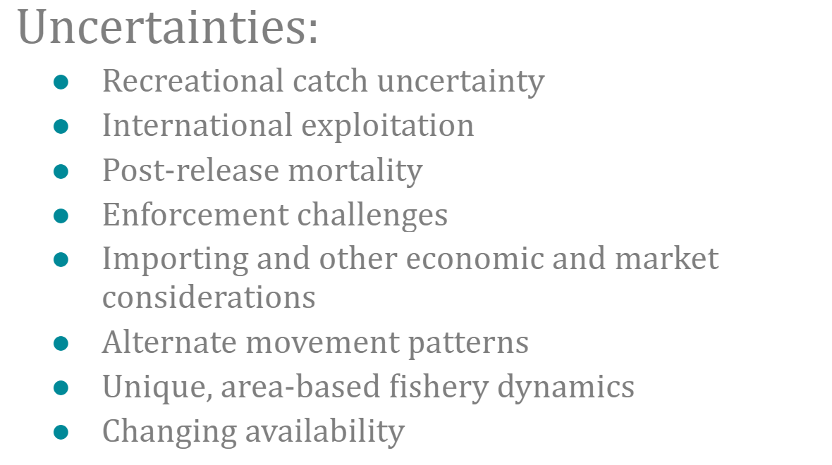
To do: OM specification
From 2022 pptx Macpherson et al. ‘Contested causation and the fight over South Florida’s favorite game fish’:

Slide 28
To do: other
Splash page
Trial Specifications Document
Help documentation (how to run analyses, design MPs etc)

Slide 29
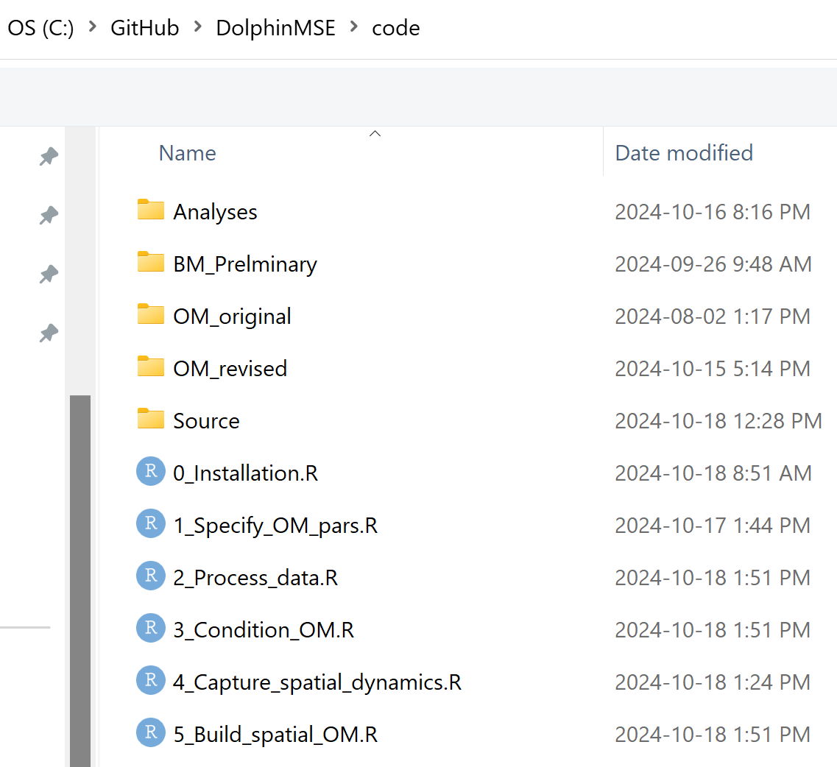
Navigating the GitHub

Slide 30
6. Presenting result to the group

Slide 31
Tentative Schedule
---- End of Jan 2025 --- Presentations on work with the aim of getting to the end of the INITIAL phase. These are a show and tell of a working MSE framework with OMs, MPs and metrics building off all the work you have done previously on this MSE) ---
--- End of April, early June 2025 - In person meetings with the aim of getting to the end of the REVISION phase. These are an update of what was presented in Jan 2025 (there could be quite a bit of work in this major revision since Jan)
--- Early September 2025 - Virtual meetings with the aim of getting to the end of the REFINEMENT phase. This ends in a vetted MSE framework (no MP adopted but the basis for adoption supported by scientists, stakeholders and managers).
--- November Review of MSE framework ---

Slide 32
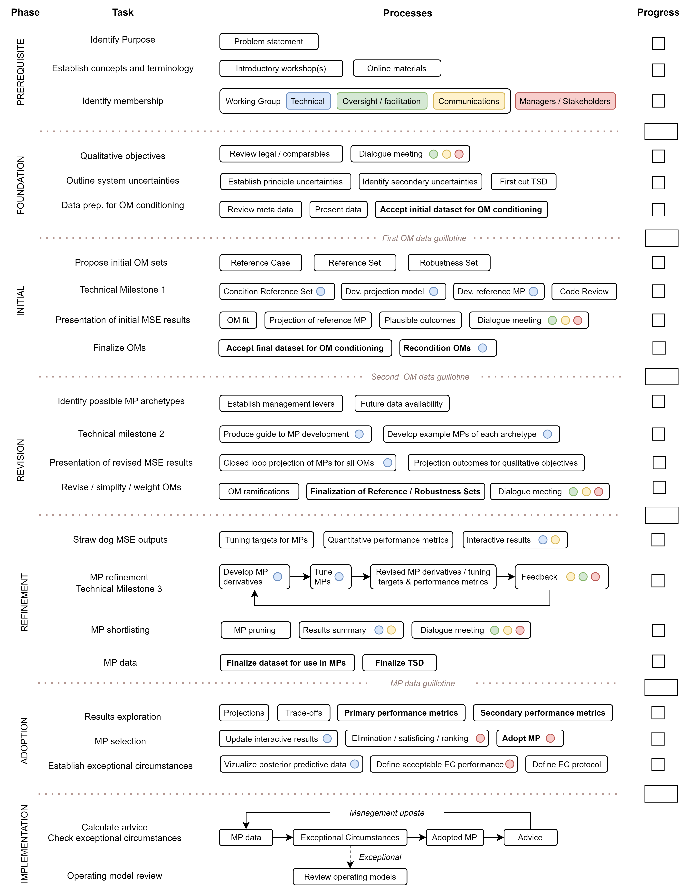

---- End of Jan 2025 --- Presentations on work with the aim of getting to the end of the INITIAL phase. These are a show and tell of a working MSE framework with OMs, MPs and metrics building off all the work you have done previously on this MSE) ---
* Presentation 1 is to scientists checking uncertainties (reference / robustness sets, data streams, future data streams, MP types)
* Presentation 2 is to managers checking uncertainties MP types, performance metrics / objectives. What is the MP adoption horizon (how long should the MP be used?) and how often should advice be updated?
It would be good to have initial results in Slick for these presentations.

Slide 33
--- End of April, early June 2025 - In person meetings with the aim of getting to the end of the REVISION phase. These are an update of what was presented in Jan 2025 (there could be quite a bit of work in this major revision since Jan)
* Meeting 1 is among scientists to make sure everyone is happy with the data, OMs, OM conditioning, projection conditions etc.
* Meeting 2 is among stakeholders and managers. Are the MPs suitable, do metrics encompass interests, legal requirements etc? What tunings / MP archetypes / derivatives are they interested in?

Slide 34
--- Early September 2025 - Virtual meetings with the aim of getting to the end of the REFINEMENT phase. This ends in a vetted MSE framework (no MP adopted but the basis for adoption supported by scientists, stakeholders and managers).
* Meeting 1 is scientific, Meeting 2 is stakeholder / manager. Can they sign off on this as a basis for calculating MP performance and potentially selecting an MP (recognizing that ECP will be employed and the framework will be revised after X years anyway).

Slide 35
-- November Review of MSE framework ---
I'm guessing the focus here is not on the MP to be adopted but the basis for a potential adoption. Is the MSE framework sound?

Slide 36
Thanks! Special thanks to Matt and Cassidy for all of their help with data and patience explaining things! Shout-out to Jeff Buckel for his expertise on life history.

